Slide 1
Book Store Management System
A project by: -
Satvik Sattenapalli (20070123089)
Praneet Maria (20070123105)
Pratham talekar (20070123113)
Parth Nikam (20070123120)

Slide 2
Introduction
The mini-project “Book Store management system project in C” is a console application using the C programming language. The aim of this project is to simulate the working i.e., all the functions of a real-world bookstore – hence the name ‘Bookstore Management System’ through the mode of a console application. The code for this program is designed to perform operations such as Inserting a new book name/author/rating to a read/unread list and perform the delete operation for the same, in addition to this, the program also facilitates the viewing of all of the items in the list of read/unread books.
This application of Data Structures (in C) was specifically chosen by our group considering current trend data and other related info. Post the severity of the Coronavirus Pandemic, several old retail practices have suffered a considerable pitfall in terms of sales figures and even to the point of being closed. In an article by VOX media, the percentage of imminent threat to closing of independent bookstores in terms of being shut down was estimated to an aggregate of twenty. This is despite the functioning of several renowned charitable foundations. Hence, we decided to build a console application system wherein, bookstores can add the data pertaining to the stock of books in-store or in their respective inventories.

Slide 3

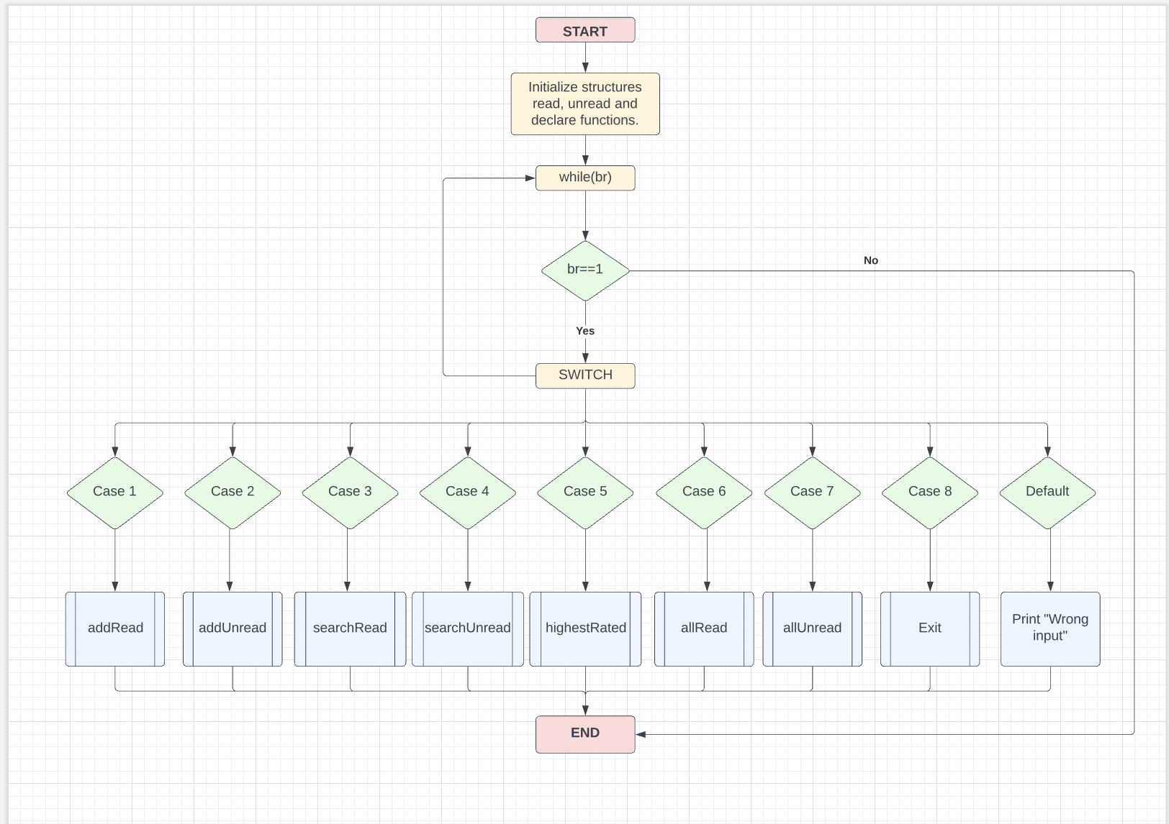
Flow Chart

Slide 4
COde
https://github.com/AiryAir/BookstoreManagement

Slide 5
Algorithm
Start
Declare and define functions
Define struct read and unread
Set variables br to 1 and choice = 0
while (br)
case 1 :
call addRead()
break
case 2 :
call addUnread()
break
case 3 :
call search()
break
case 4 :
call searchUnread()
break
case 5 :
call highestRated()
break
case 6 :
call allRead()
break
case 7:
call allUnread()
break
default
END

Slide 6
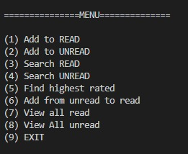
Output Screen

Slide 7
Thank You

